Slide 1
Joint EESC-CoR Conference: Cork+20: leaving rural areas behind is no longer an option! Brussels, 9 November 2016
Evolution of the EU budget dedicated to
rural development
- main findings of a study carried out for the Committee of the Regions -
Rossella Soldi
Progress Consulting S.r.l.
www.progresscons.com
Consortium:
Progress Consulting S.r.l., Firenze, Italy (lead firm)
Living Prospects Ltd, Athens, Greece
Framework Contract :
CDR/DE/138/2011
Order Form No 6275

Slide 2
Multiannual Financial Frameworks (MFF) considered: since 1993
1993-1999 (‘Delors II package’)
2000- 2006 (‘Agenda 2000’)
2007-2013
2014-2020
Funds considered
Financing the Rural Development Policy
Up to 2006: EAGGF (European Agricultural Guidance and Guarantee Fund)
From 2007: EAFRD (European Agricultural Fund for Rural Development)
Supporting rural areas and/or rural development
ERDF (European Regional Development Fund)
ESF (European Social Fund)
CF (Cohesion Fund)

Slide 3
1. Main findings on EAGGF/EAFRD
Absolute amounts allocated for RDP
Increasing allocations from 1994 to 2006. More or less comparable allocations in the last two programming periods (2007-2013 & 2014-2020).
Financing of RDP as a share of total appropriations
Increasing from 1993-1999 to 2007-2013. Decreasing from 2007-2013 to 2014-2020.
Financing of LEADER
Increasing allocations from 1994 to 2020. Increasing shares of total appropriations from 1994 to 2006; comparable shares of totals allocated to LEADER over the 2007-2013 & 2014-2020 periods.
Financing of RDP at the country level in the last two MFF
High variability across countries.

Slide 4
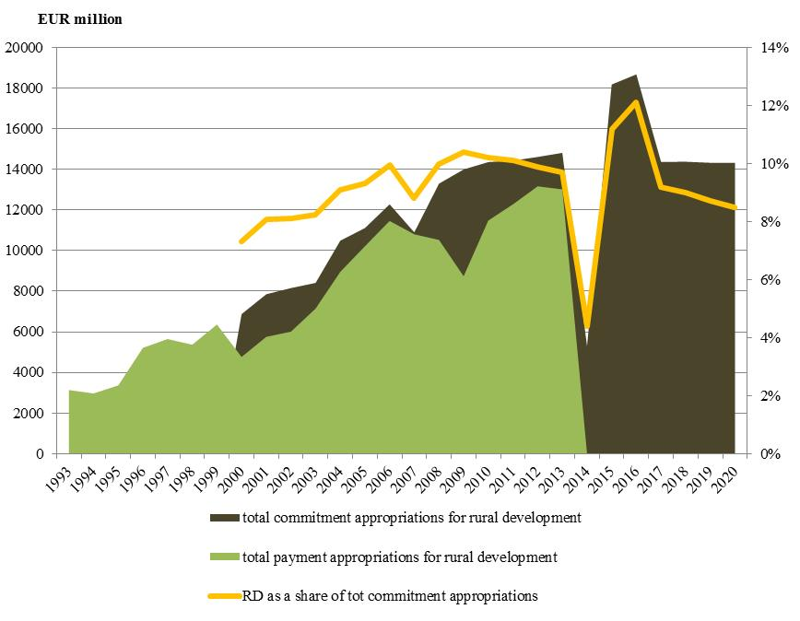
1. contd.
Overview
(*) payment appropriations
Evolution on a yearly basis since 1993

Slide 5
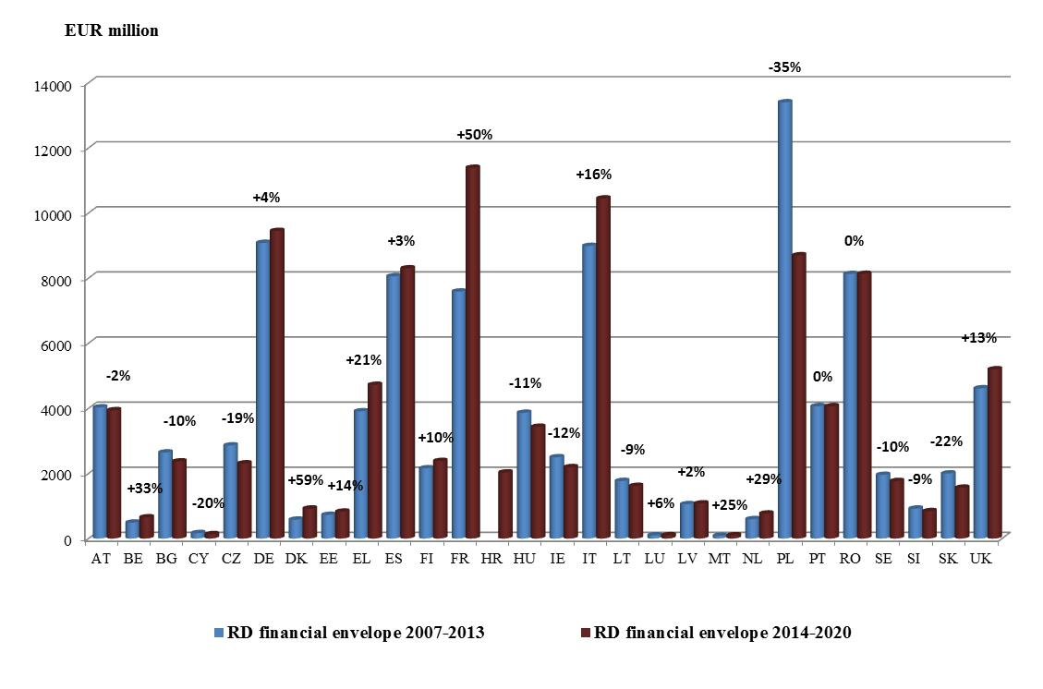
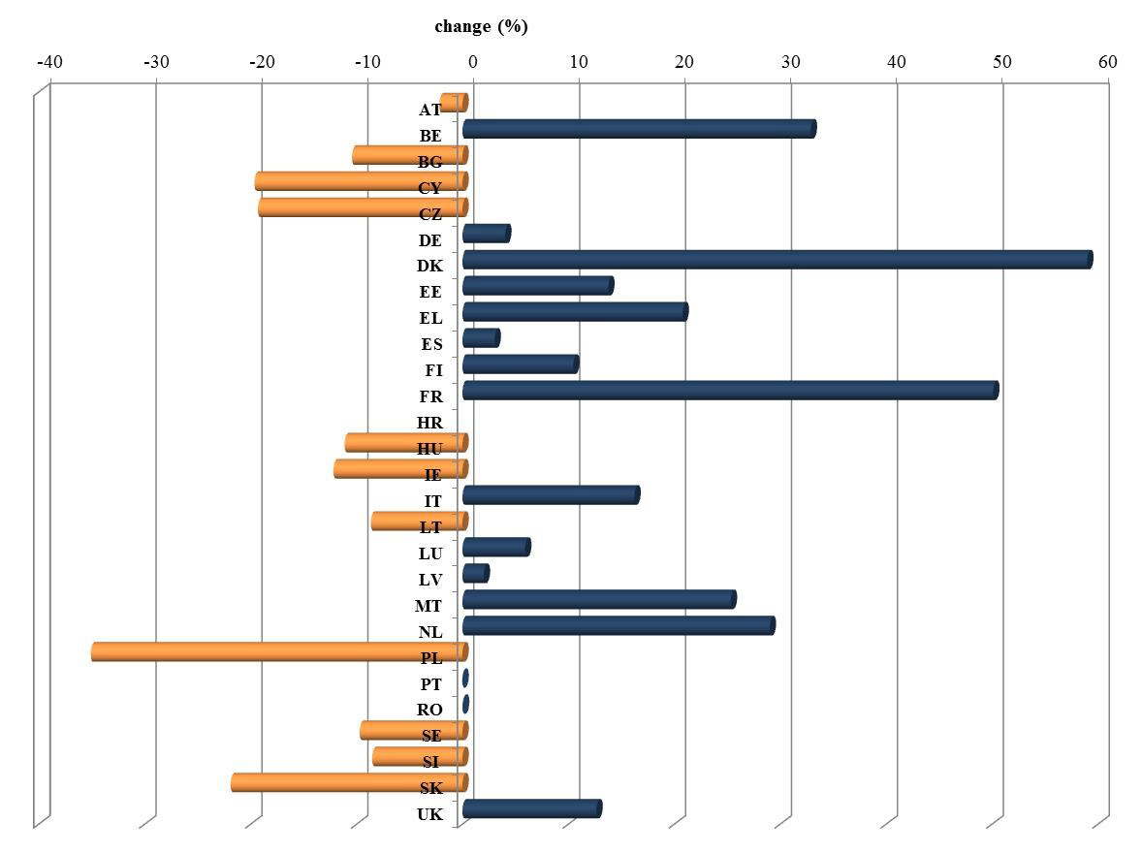
1. contd.
High variability across countries:
commitment appropriations for RDP (EAFRD) at the national level
in the last two programming periods and change

Slide 6
2. Main findings on ERDF, ESF, and CF
Uncertainty of figures
Lack of appropriate categorisation of commitments and expenses. When such categorisation exists, it is not coherent across programming periods → estimates, uncertain amounts.
(not a ‘new’ problem; faced by past ex-post evaluations of Structural Funds; situation expected to improve substantially from the current programming period onwards as the territorial dimension ‘rural areas’ has been introduced).
Financing of rural areas by ERDF is important but decreasing
Substantially increasing from 1993-1999 to 2007-2013. Significantly decreasing from 2007-2013 to 2014-2020.
Financing of rural areas by ESF and CF is minimal
Minimal contribution across all programming periods, including the current one.

Slide 7
2. contd.
Evolution of the EU budget benefiting rural development/rural areas from ERDF, ESF, and CF - as a share of total MFF appropriations
(1) Payment appropriations.
(2) It includes 50% of combined contribution ERDF/CF to RD. The 50% share between the two funds is arbitrary.
(*) not available
Planned share of funds dedicated to rural development over the totals allocated to each fund – MFF 2014-2020

Slide 8
3. Overview and conclusions
(1) Payment appropriations
The current programming period (MFF 2014-2020) has a planned total allocation for RD which appears, overall, to be much lower than the RD allocation of the previous programming period.
This lower contribution to RD seems to be mostly determined by a significant lower contribution from the ERDF compared to the previous programming period.

Slide 9
Joint EESC-CoR Conference: Cork+20: leaving rural areas behind is no longer an option! Brussels, 9 November 2016
Thank you!
Thank you!
Rossella Soldi
Rossella Soldi
Progress Consulting S.r.l.
Firenze, Italy
www.progresscons.com

